Slide 1
Data Science
with R
By Anthony Castillo

Slide 2

What is R?
https://www.r-project.org
https://www.rstudio.com

Slide 3
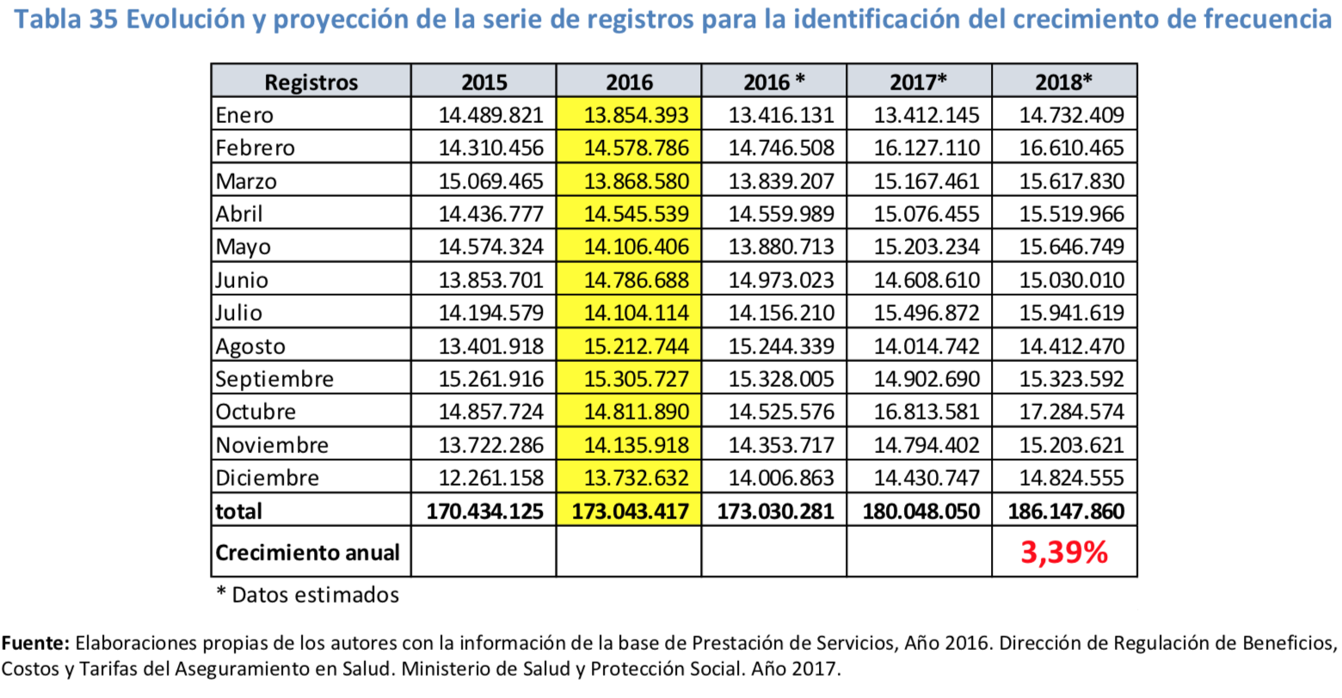
Our data...
https://www.minsalud.gov.co/salud/POS/Paginas/unidad-de-pago-por-capitacion-upc.aspx
Click on the “2018” link (Under “Estudios de Suficiencia”) and scroll down to the bottom of page 79 for this lecture’s data.

Slide 4
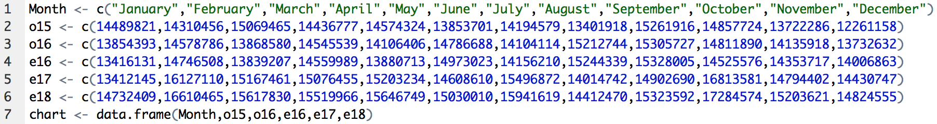
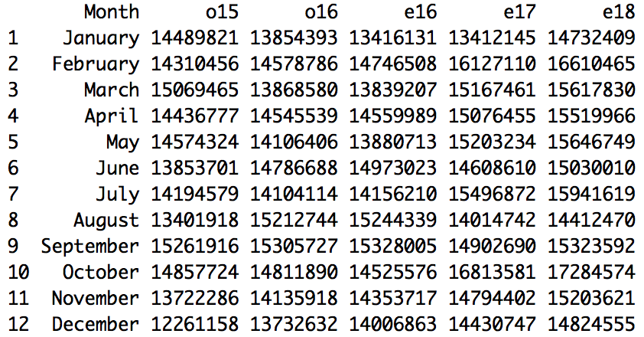
Creating the Dataframe...

Slide 5
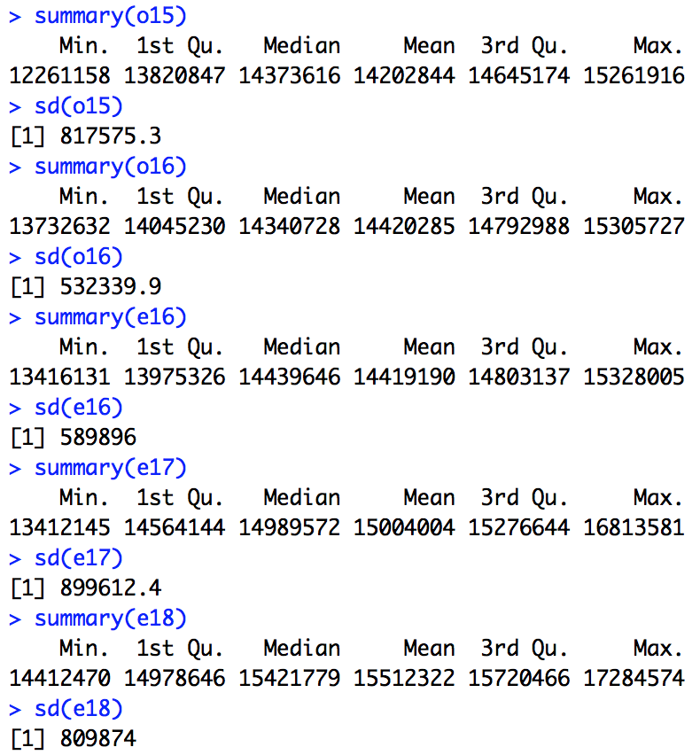
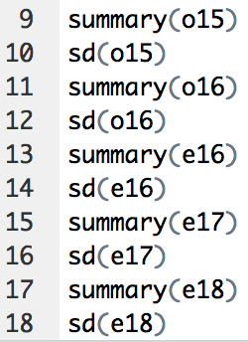
Getting the Number Summaries...

Slide 6
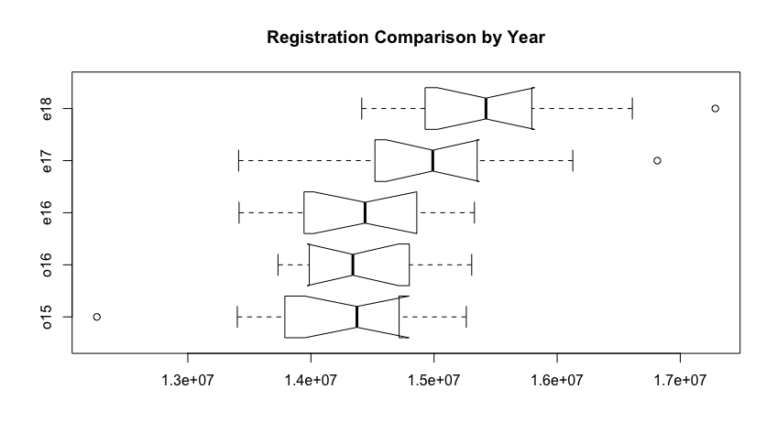
Creating the Box-and-Whisker Plots:
19)
boxplot(o15,o16,e16,e17,e18, main="Registration Comparison by Year", names=c("o15","o16","e16","e17","e18"), horizontal=TRUE, notch=TRUE)

Slide 7
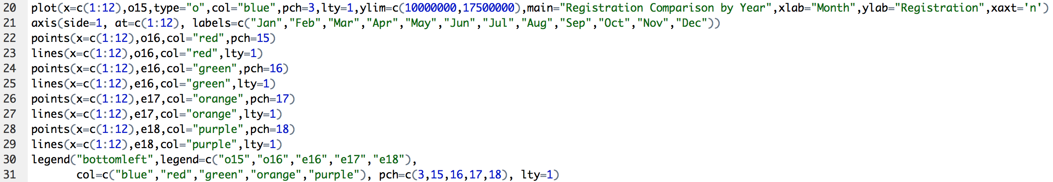
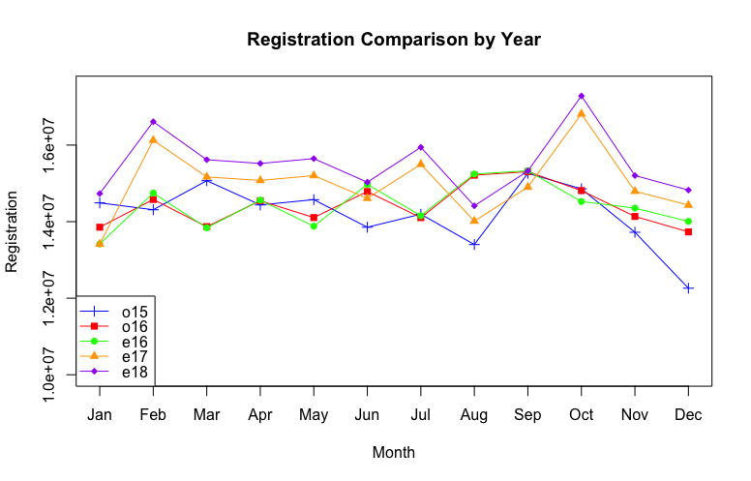
Creating the Line Plots...

Slide 8

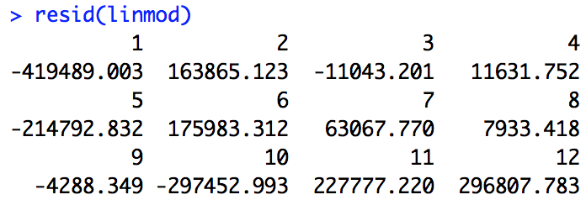
Calculating the 2016 Residuals...

Slide 9
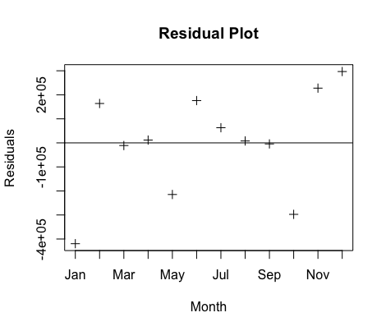
Plotting the Residuals

Slide 10
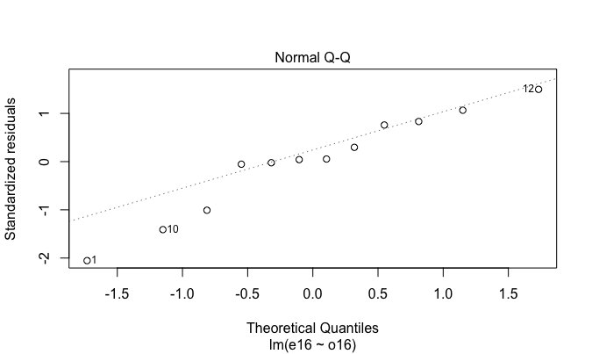
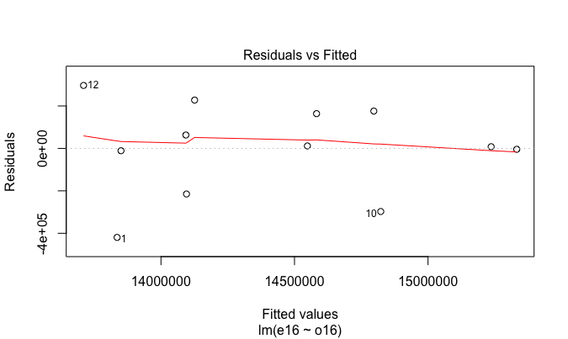
Analyzing the Residual Plots...
37) plot(linmod)

Slide 11
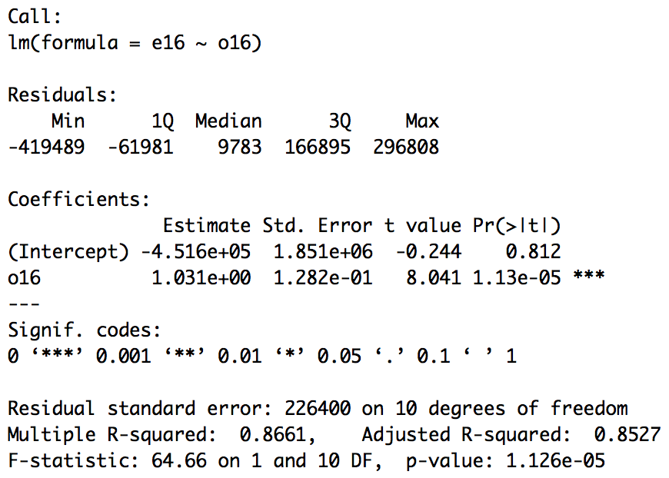
Interpreting the Residual Number Summary...
38) summary(linmod)

Slide 12
Deriving the Normal Linear Regression Coefficients...
38) summary(linmod)

Slide 13
Analyzing the R-squared Coefficient...
38) summary(linmod)

Slide 14
Testing the Null Hypothesis...
38) summary(linmod)

Slide 15
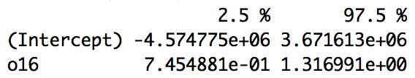
Deriving the 95% Confidence Interval...
39) confint(linmod)

Slide 16
Why?

Slide 17
Sources...
PSTAT 10 w/ Prof. Dawn Holmes (Fall 2017)
PSTAT 126 w/ Prof. Todd Gross (Spring 2018)

Slide 18
Any questions?

